Slide 1
Bpcc meeting
September 25, 2018

Slide 2
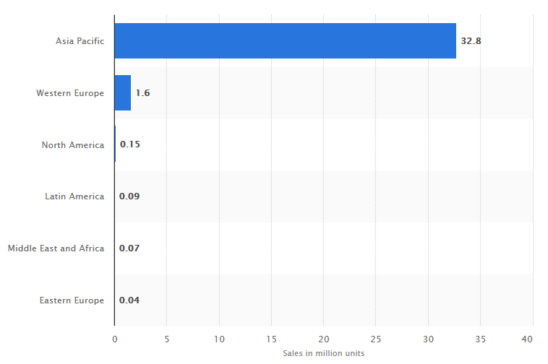
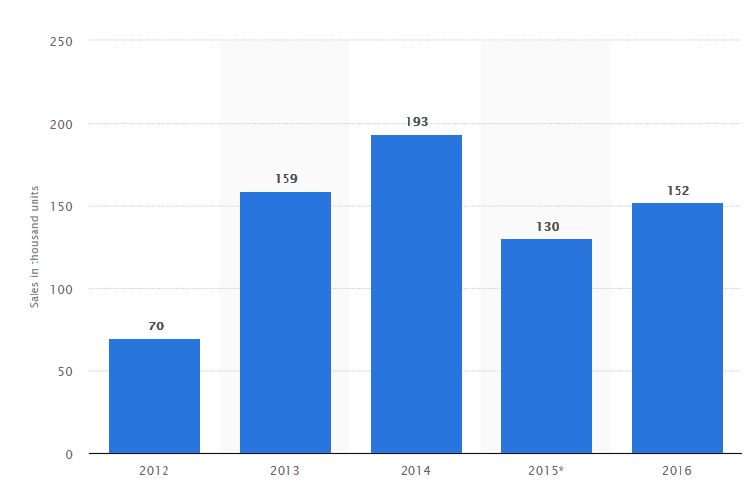
E BIKE SALE IN USA 2012 – 2016 (In Thousands)
WORLDWIDE SALE OF E BIKES IN 2016 BY REGION
China accounted for 92% of global sales in 2016
34 Million sold globally in 2017
263,000 units sold in USA in 2017
Global E Bike sales to reach 40 million units in 2023

Slide 3
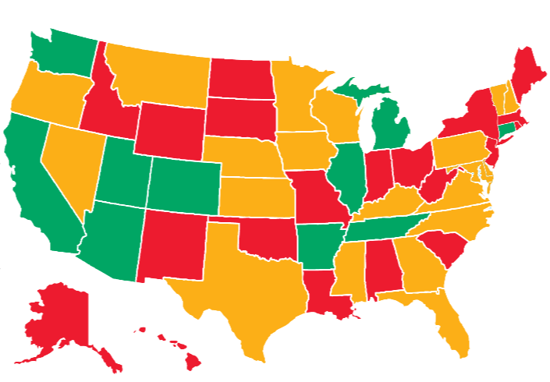
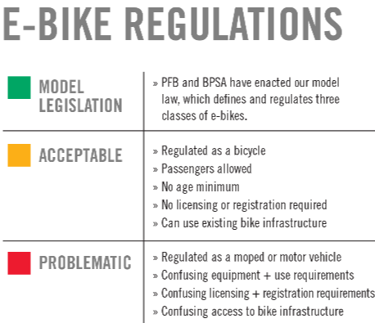
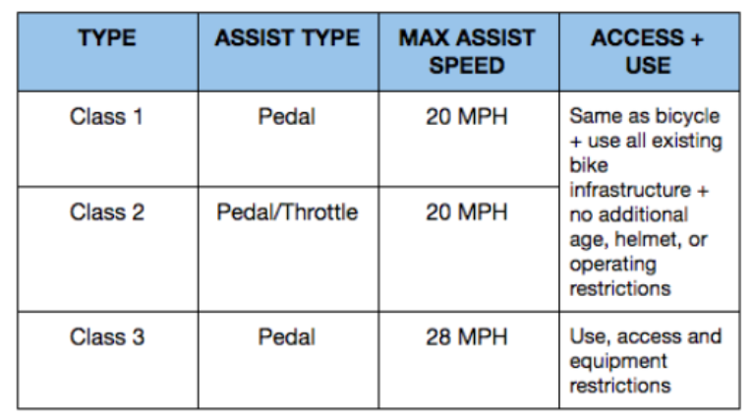
WA
UNDER STATE MOTOR VEHICLE CODES
Defines and regulates three
Classes of e-bikes
Requires labels
MI
CE
CA
UT
IL
CO
AK
AZ
TE
Source: People for Bikes
30 states define electric bicycles
10 have Model E Bike Laws
State vehicle codes do not apply to E-Mountain Bikes
Notes:
Utah and Tennessee does not allow e bikes on sidewalks but allows them on bike paths; Washington allows E1 and E2 on bike paths; Illinois does not allow e bikes on sidewalks; Az, MN and DE allows them on sidewalks and bike paths; Connecticu, MA does not allow them in sidewalks and bike paths;

Slide 4
FLORIDA STATUTES
FS 316.003 (3) Bicycle-Every vehicle propelled solely by human power, and every motorized bicycle propelled by a combination of human power and an electric helper motor capable of propelling the vehicle at a speed of not more than 20 miles per hour on level ground upon which any person may ride, having two tandem wheels, and including any device generally recognized as a bicycle though equipped with two front or two rear wheels. The term does not include such a vehicle with a seat height of no more than 25 inches from the ground when the seat is adjusted to its highest position or a scooter or similar device.
A person under the age of 16 may not operate or ride upon a motorized bicycle
Florida definition of an e bike is consistent with a Class 1 classification
Class 2 and Class 3 bikes are Mopeds and require Class E license and registration
Pedal assisted e-bike with speeds over 30 mph is a motor cycle
316.008 - Powers of Local Authorities
(1) Provisions of this chapter shall not deemed to prevent local authorities, with respect to streets and highways under their jurisdiction and within the reasonable exercise of the police power from
(h) Regulating the operation of bicycles
316.995 Except as provided in s. 316.008 or s. 316.212(8), a person may not drive any vehicle other than by human power upon a bicycle path, sidewalk, or sidewalk area
If the electric motor is disengaged then you could legally ride a Class 1, 2 (with pedal option) or 3 e-bike on sidewalks and bike paths
Notes:
Consumer Product Safety Commission (CPSC) Regulation – electric motor less than 750 watts (1 HP) and max speed of less than 20 mph for a 170 lb rider
Meets manufacturing requirements under the Consumer Product Safety Act as opposed to manufacturing equipment requirements under motor vehicle safety act

Slide 5
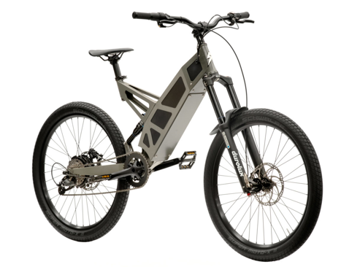
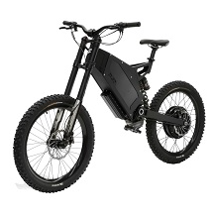
SAFETY CONCERNS
Unpredictability - Motorists underestimate speed of e-bikes and have been involved in near crashes
Safety hazard for pedestrians and slower cyclists
Dutch Study: 20% e-bike crash injuries end up in ICUs
2015 Swiss Study: e-bike accidents more serious
2014 Danish Study: 10% of all cyclist fatalities
Accounted for 37% of all crash injuries in China 2015
Illegal e-bikes on roadway
Excessive speeds on home made conversion bikes
Powerful E Mountain bikes on public roads
Ft Myers Beach only local government in Florida to have passed e-Bike regulation based on safety concerns
Not allowed on sand, sidewalks, and bike paths
First offense gets a warning followed by $50 fine
Challenges
STEALTH P-7, P-7R
(20 MPH) (28 MPH)
$5,300, $6000
500 Watt, 1000 watt
STEALTH B-52
Top Speed – 50 MPH
$9,900

Slide 6
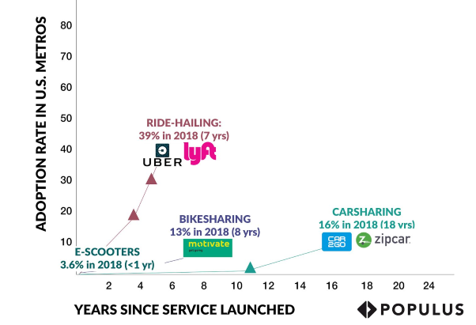
COMPARISON OF MOBILITY SERVICE ADOPTION CURVES IN US
WHY ARE SHARED E-BIKE AND SCOOTER SERVICES BECOMING POPULAR
Easy to use and low user costs
Smart phone proliferation
adoption has grown from 35% in 2011 to 77% in 2018
Expands mobility options
Very convenient for first and last mile trips
Faster than ride-hailing services for trips 3 mile or less
Representative sampling of over 9000 users across 11 major cities

Slide 7
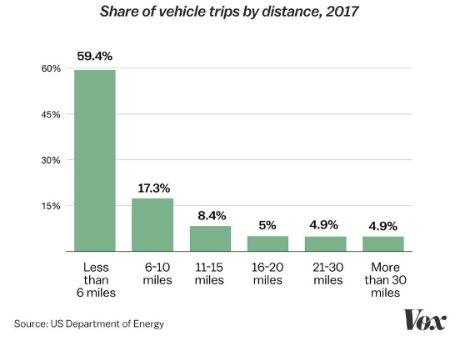
SHARE OF VEHICLE TRIPS BY DISTANCE 2017
45% of car trips are 3 miles or less

Slide 8
ELECTRIC SCOOTERS AND FLORIDA STATUTES
FS 316.003 (44) MOTORIZED SCOOTER —Any vehicle not having a seat or saddle for the use of the rider, designed to travel on not more than three wheels, and not capable of propelling the vehicle at a speed greater than 30 miles per hour on level ground.
Manufacturing does not meet Federal Motor Vehicle Safety Act requirements
Cannot be titled or registered
Cannot be operated on public roads and sidewalks
Must carry a driver’s license
316.008 - Powers of Local Authorities
(7)(a) county or municipality may enact an ordinance to permit, control, or regulate the operation of vehicles, golf carts, mopeds, motorized scooters, and electric personal assistive mobility devices on sidewalks or sidewalk areas when such use is permissible under federal law. The ordinance must restrict such vehicles or devices to a maximum speed of 15 miles per hour in such areas

Slide 9
Rapid rate of private investment in Shared E-Bike and Scooter market
Emergence of startup companies like Lime, Bird, Spin, Jump (Uber), Scoot, Skip
Bird valued at $2 billion, Lime at $1.1 billion, Skip at $100 million
FAMILIAR STRATEGY: Rogue release of E-Scooters and a strategy for act first and forgiveness later (San Francisco/Miami/Santa Monica/Milwaukee/…………….)
Cities forced to
Issue cease and desist letters
Pass legislation and introduce Pilot Programs
Issue operating permits, execute contracts
Shared E-Scooter programs launched in over 75 cities across US in fall 2017 and spring 2018
E-SCOOTER SHARED MOBILITY PROGRAM
Notes:
Backed by venture capital from Uber, Sequoia Capital and Alphabet Inc.
Cambridge/LA/Nashville/Washington DC/Reno/Indianpolis/Scottsdale/Fresno/Austin/Denver/Milwaukee

Slide 10
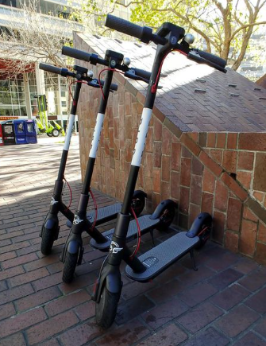
BUSINESS MODEL
E Scooter Shared Mobility companies cover 100% of equipment, marketing, and operation costs
Going dockless saves millions to operators
Ride share apps for locating scooters, payment, unlocking
$1 to unlock plus $0.15 per every minute
$2.50 for 10 minutes, $10 for 1 hour
Low cost maintenance through independent contractors
Juicers/Mechanics/Fleet Gatherers
Makes $5 to $20 per scooter
Miami juicer made $90/day
Notes:
Result of the gig economy

Slide 11
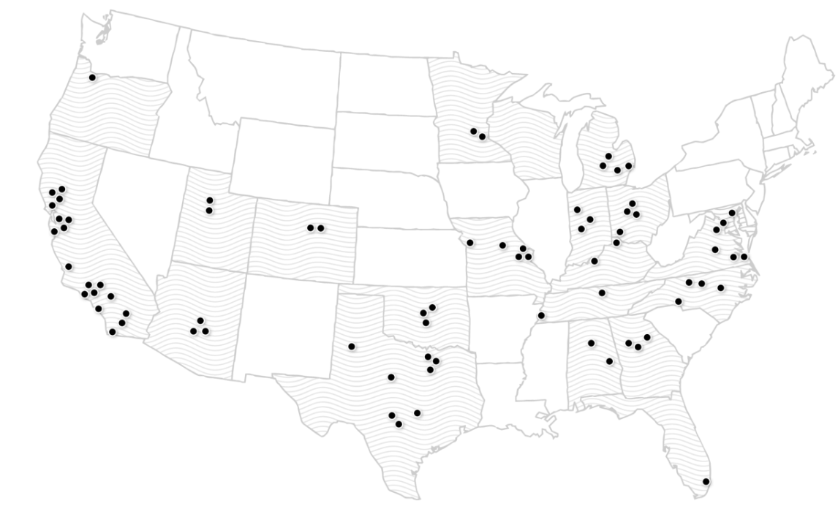
BIRD OPERATES IN 75 CITIES
Source: Bird Website

Slide 12
FLORIDA LOCAL GOVERNMENT LEGISLATION
City of Coral Gable first city in Florida to regulate Electric scooters
Pilot Program launched and extended to November
Contract with Spin and Lime for deployment of scooters
Restricts 75 scooters per operator at any one time
Some restrictions on scooter operation on sidewalks
Final decision to be made by City Commission after pilot program
City of Miami (10,000 Miamians made 30,000 trips before cease and desist notice)
Legislation proposed to amend Chapter 8 of City Code
Establishes 6 month pilot program
E scooters to be deployed in Downtown, Brickel, and Coconut Grove
Provision to extend pilot program
Sets rules for fleet size, data sharing, etc.
50 scooters each for first 2 weeks, another 50 the following week
Monthly reevaluation - increase by 25% if each scooter used at least 3 times/day
Scooters will be permitted on both streets and sidewalks
Lime targeting City of Fort Lauderdale
Notes:
August 28 initial expiration date
Ponce De Leon/Miracle Mile/Girals Plaza

Slide 13
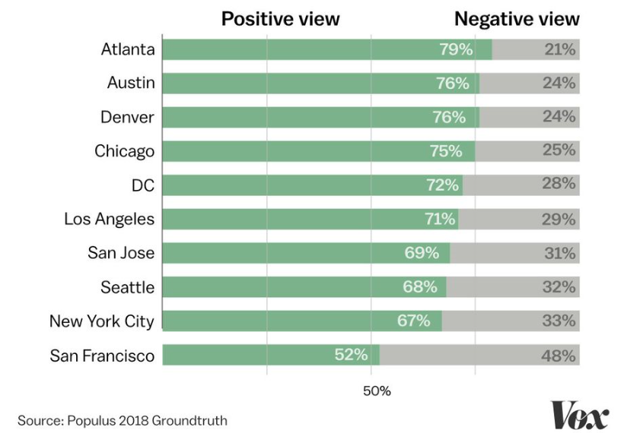
PUBLIC PERCEPTION OF E-SCOOTERS BY CITY
Notes:
Populus conducted study based on a representative sample in May and June 2018 of over 7,000 people across 11 US cities

Slide 14
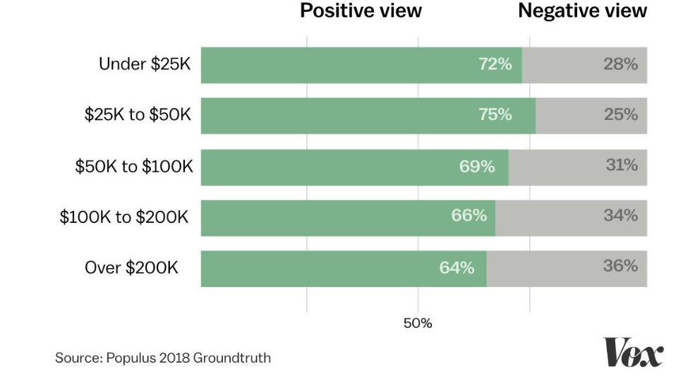
PUBLIC PERCEPTION OF E-SCOOTERS BY INCOME
Dockless shared electric bikes and scooters increases transportation equity

Slide 15
SAFETY CONCERNS
San Francisco trauma specialists reported scooter injuries ranging from skinned knees to head traumas
5 to 10 e-scooter related injuries a week
Washington Post reported that scooter accident victims are showing up at ERs with broken noses, wrists and shoulders, facial lacerations and fractures
34 serious accidents reported in Santa Monica
Bird is forming a e-scooter safety advisory council led by former NHTSA official
Lobbying against California legislation on use of helmets
Data collection challenges
Scooter crash injury is reported under ‘other’ injuries
Learning curve, lack of riding etiquettes
No safety regulations -
Mechanical failures resulting from poor maintenance
Applicants need only a vehicle and smart phone to qualify

